Slide 1
SAP Application Interface Framework (AIF)
Krishnan Iyer
Prem Shankar
Avishek Sengupta
Abhishek Juyal
Aditya Kamat
Deepika Velivela
Deloitte Consulting LLP
July 2020

Slide 2
Training Agenda
Day 1
AIF Overview and Framework
AIF with Proxy Scenario – Theory and Hands-on
Day 2
AIF with IDoc Scenario – Theory and Hands-on
Day 3
AIF with RFC Scenario – Theory and Hands-on
Miscellaneous Topics / Project Experiences / Use Cases
Q&A / iCertify Exam

Slide 3
Contents
Why Interface Error Handling
Error Classification and Key Definitions
Interface Monitoring
Application Interface Framework – Introduction and Architecture Overview
Application Interface Framework – Interface Monitoring
Application Interface Framework – Interface Error Handling
Application Interface Framework – Alerts and Notification
Application Interface Framework – Use Cases
Application Interface Framework – Error Message Reprocessing
Comparison of Monitoring and Error Handling Tools
Interface Implementation with AIF
Q&A

Slide 4
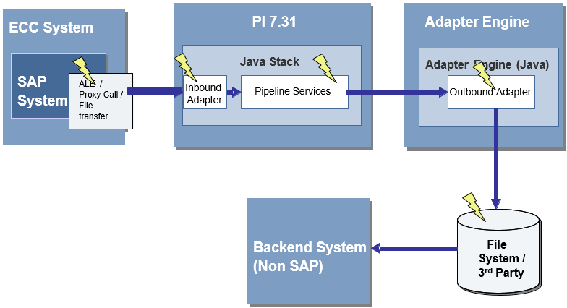
Why Interface Error Handling
'Run time Interface errors are inevitable’
No matter how good the interface design is, there is always the human factor, which manifests itself in bad data or user errors. In addition, there are technical issues, such as the unavailability of the network or the target system(s), which would also lead to the same result.
Need for a Framework
Interfaces solution in a typical system landscape can be vast and varied
due to various factors like:
Different kinds of source and target systems,
Different modes of communications,
Batch/online requirements,
External and internal communications etc.
To enable smooth operations of this interfaces solution,
it is important to devise a framework that allows classifying
errors into categories and provides guidance
on technical implementation of how each category is handled.
Enable common operational procedures for
monitoring and troubleshooting these errors.

Slide 5
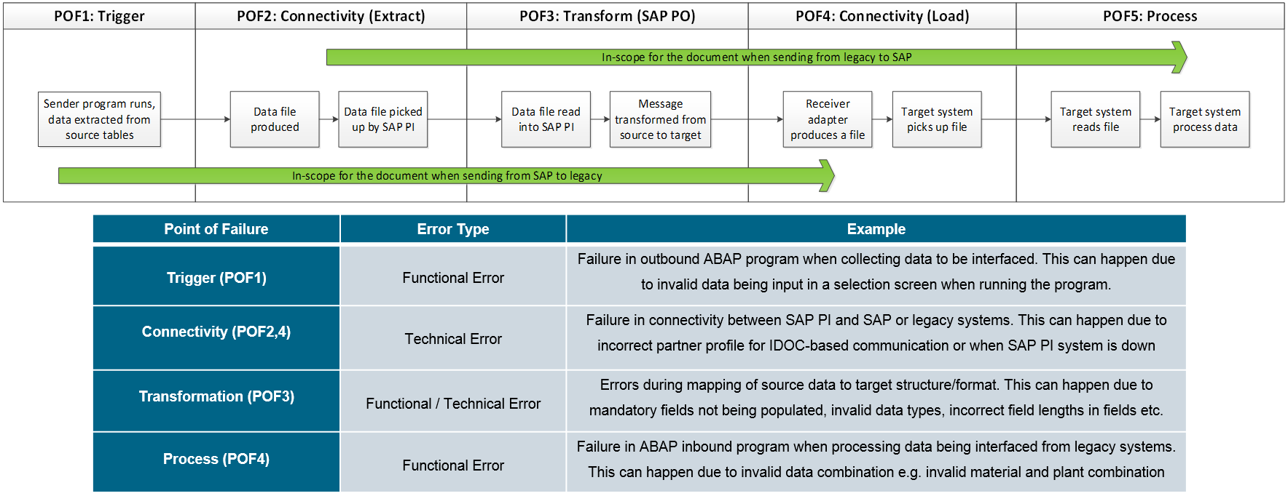
Error Classification and Key Definitions
For understanding the basis for meaningfully categorizing errors and defining a framework for handling those based on their categories, it is important to understand a typical interface flow.

Slide 6
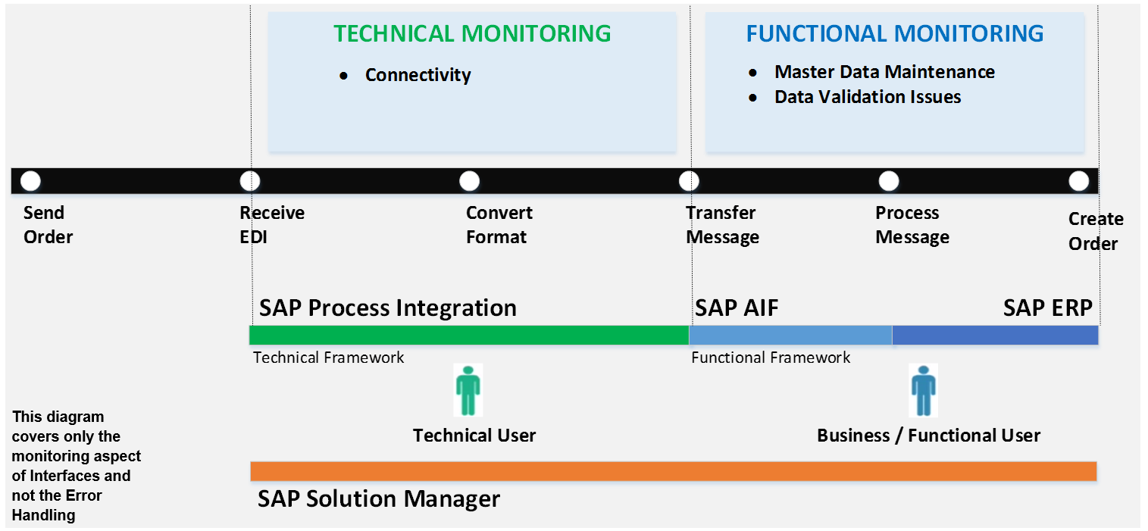
Interface Monitoring
Interface Monitoring can be broadly divided into two categories – Technical and Functional Monitoring, wherein former is done by a Technical User and latter is done by a Business or a Functional User.

Slide 7
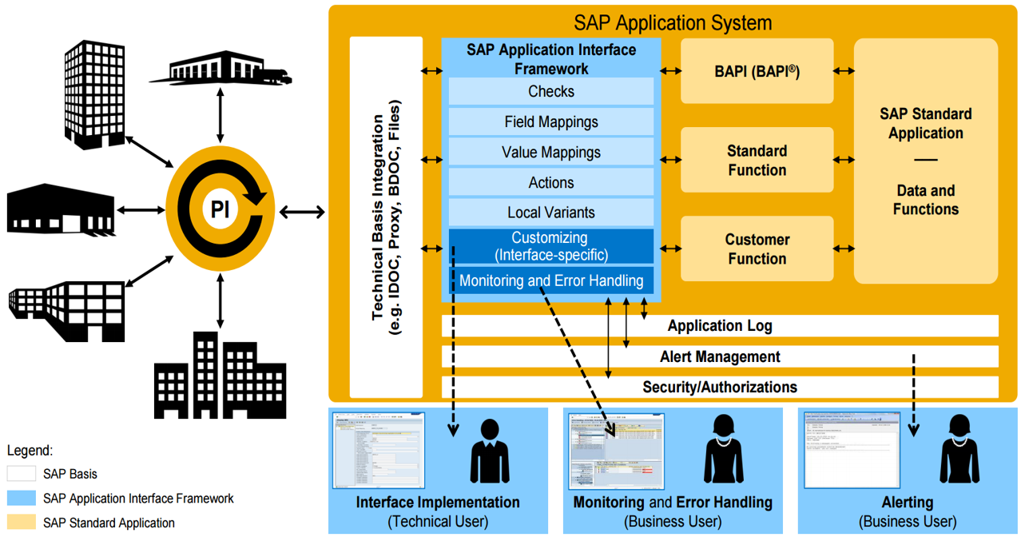
Application Interface Framework – Introduction and Architecture Overview
SAP Application Interface Framework is a powerful framework for Interface implementation, monitoring and error handling.
Interface Implementation
Interface implementation through Customizing menus
Reuse of Interface components (e.g. checks, mappings, actions)
Independent implementation and testing of Interface components
Works for inbound / outbound synchronous and asynchronous Interfaces
Monitoring and Error Handling
Business user monitoring
Customizable authorizations for Interface access
Alerting and notification capabilities also available based on message content
Capabilities for mass error handling
Auto processing feature
Payload editor available

Slide 8
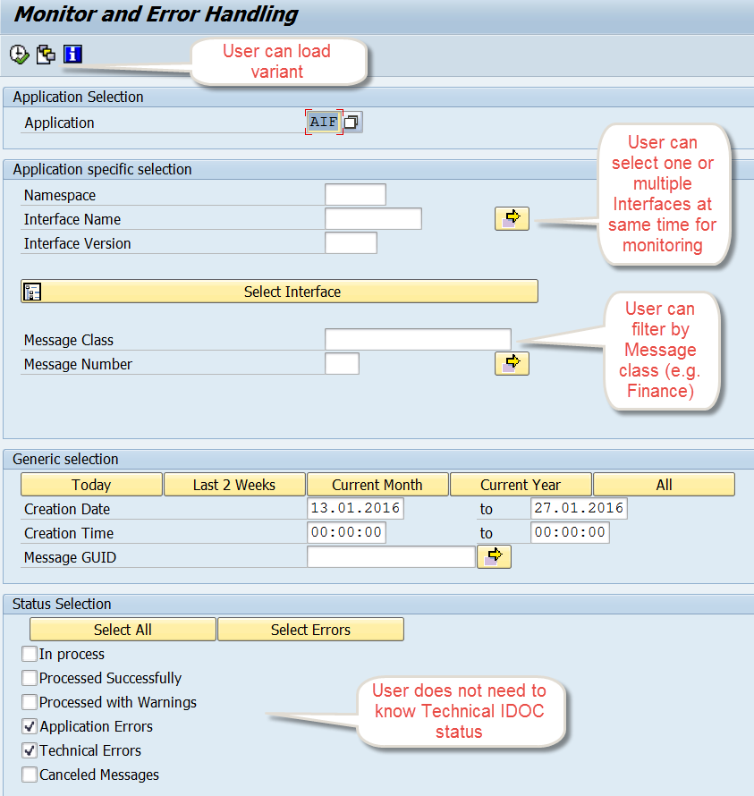
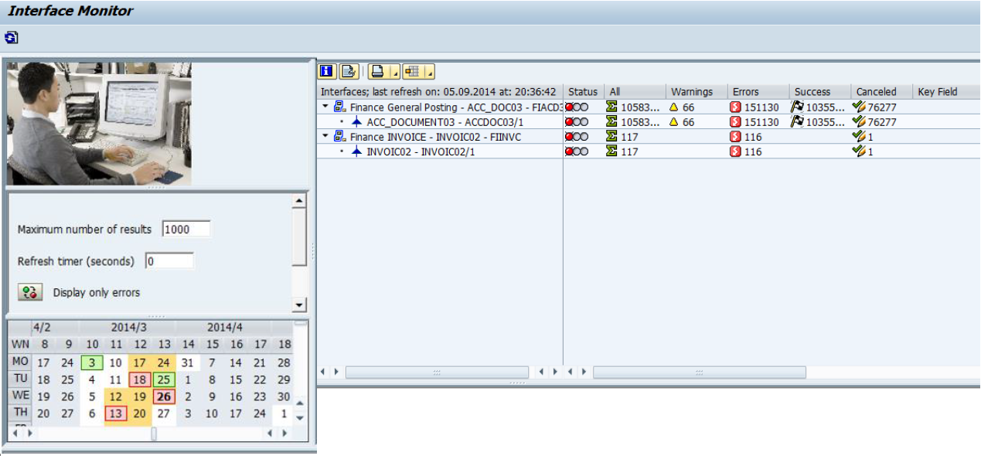
Application Interface Framework – Interface Monitoring
Personalized overview of Interfaces using t-code /AIF/IFMON. In calendar control, the days when messages are in the system are highlighted depending on the highest error status as follows:
Red: There are error messages for this one day.
There could also be successful, canceled, and warning
messages for this day.
Yellow: There are only warning messages,
or both warning and successful or canceled messages,
and no error messages for this one day.
Green: There are only successful or canceled messages
for this one day.

Slide 9
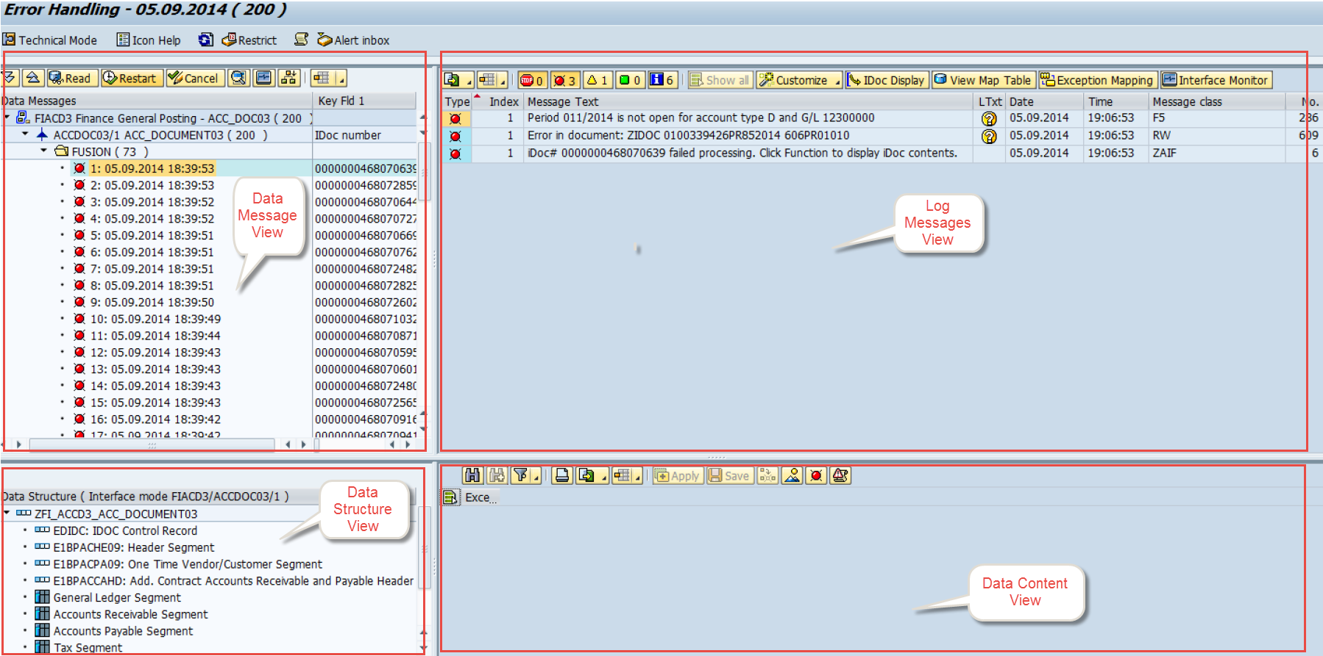
Application Interface Framework – Interface Error Handling
T-Code - /n/AIF/ERR
AIF shows multiple errors per IDOC, and not just the main message as in IDOC monitoring BD87 etc.
User doesn’t need to know the structure or the technical field names as AIF provides ‘direct forward navigation’ from error message to field causing the error (simple double click).
AIF provides capabilities for mass error handling.
Provides ability to correct errors within the system on user friendly screens.
User alerts in case of errors

Slide 10
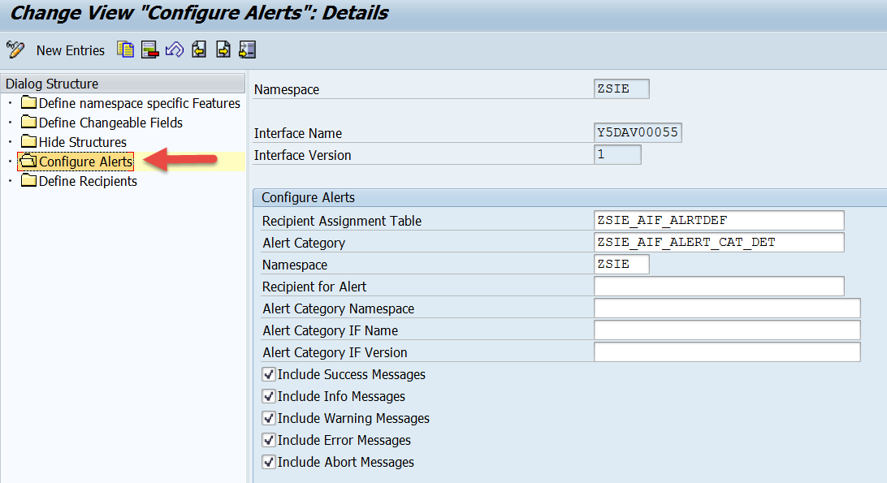
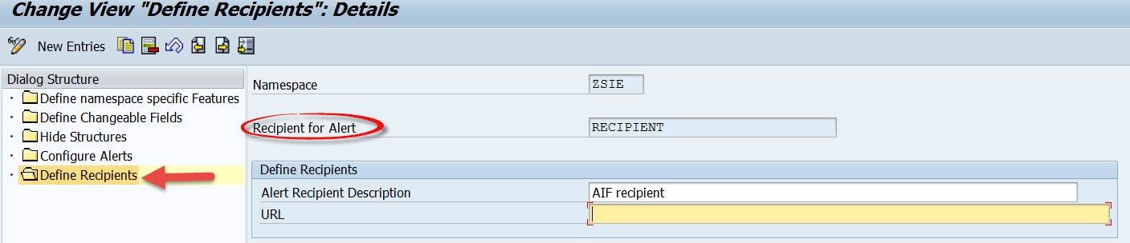
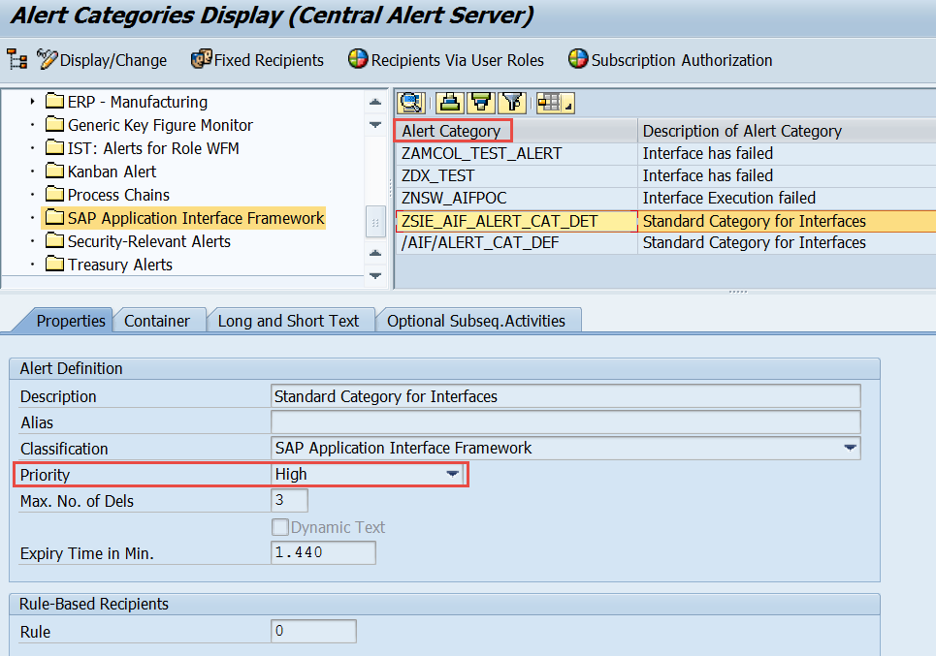
Application Interface Framework – Alerts and Notification

Slide 11
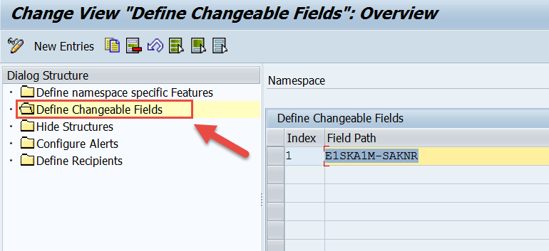
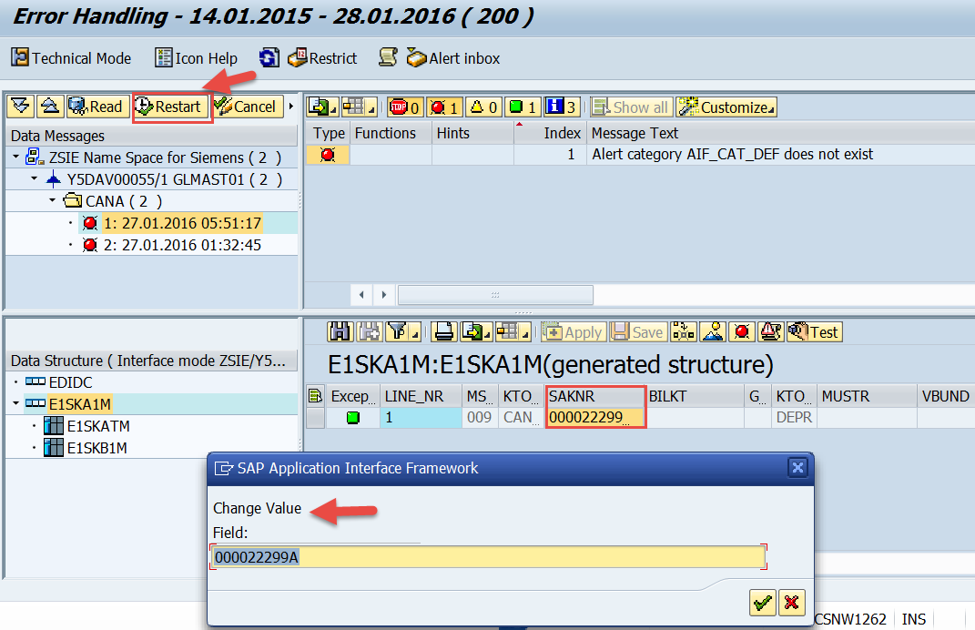
Application Interface Framework – Error Message Reprocessing
T-Code - /n/AIF/ERR
Allows to edit the payload / data
Allows to re-process or cancel the error messages
Can be used for both automatic and manual error processing
Restricts visibility of Interface data to unauthorized users
Restricts the fields that could be modified before reprocessing

Slide 12
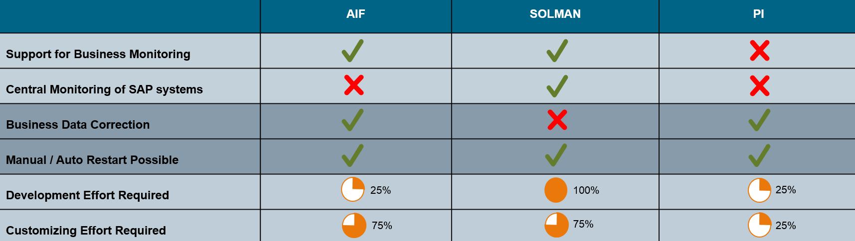
Comparison of Monitoring and Error Handling Tools

Slide 13
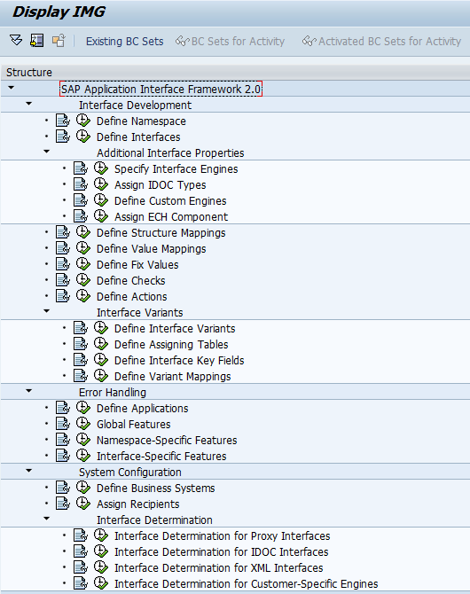
Interface Implementation with SAP AIF
Prerequisites
Create SAP & Raw Data Structure.
Define AIF Application.

Slide 14
Interface Implementation with SAP AIF
Namespaces
Logical structuring of objects and configuration
Locking mechanisms and Authorizations
Interface
An interface is the technical representation of a system interface
Connection point between the application data (SAP data structure) and the data in the external format (raw data structure)
Interface Version
Defines a version of an interface in the SAP Application Interface Framework that is used for processing a data message
A new version of an interface may vary from the original interface

Slide 15
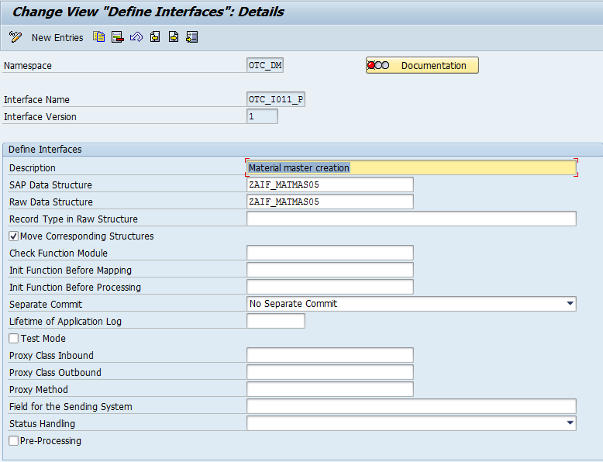
Interface Implementation with SAP AIF

Slide 16
Interface Implementation with SAP AIF
Interface Engines
Application Engine: Defines how messages should be handled in Monitoring and Error Handling. The application engine is, for example responsible for restarting and canceling messages
Persistence Engine: Different interface technologies use different persistence layers to store the data received or sent. The persistence engine is responsible for selecting, updating and locking the data content of a message
Selection Engine: The selection engine defines which messages should be displayed in Monitoring and Error Handling. The selection engine will select the messages based on the selection criteria of the selection screen
Logging Engine: The logging engine is responsible for handling the log messages written during message processing

Slide 17
Structure Mappings
In Structure mapping, the fields of the source structure are mapped to the fields of the destination structure.
Various transformation logics can be performed as below:
Define Field Mappings: The fields of the source structure need to be mapped to the fields of the destination structure. This is done using field mappings
Assign Checks: possible to check raw data or SAP data structures. Works based on “Where” condition
Define Fix Values: For a field that is supposed to have the same value every time, you can define a fix value
Define Value Mappings: You can define Value mapping to derive a value in the destination structure from up to five values in source structure

Slide 18
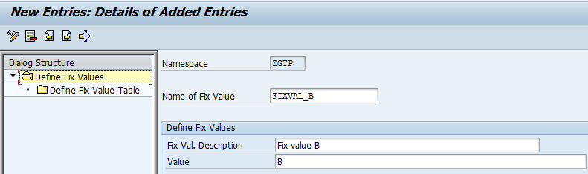
Fix Values
You can use fix values if you want a certain field in the destination structure to always have the same value.
There are two possibilities to define a fix value. The first possibility is to enter a fix value directly into the structure mapping. The second possibility is to create a named fix value, which can be assigned to a field in the structure mapping.

Slide 19
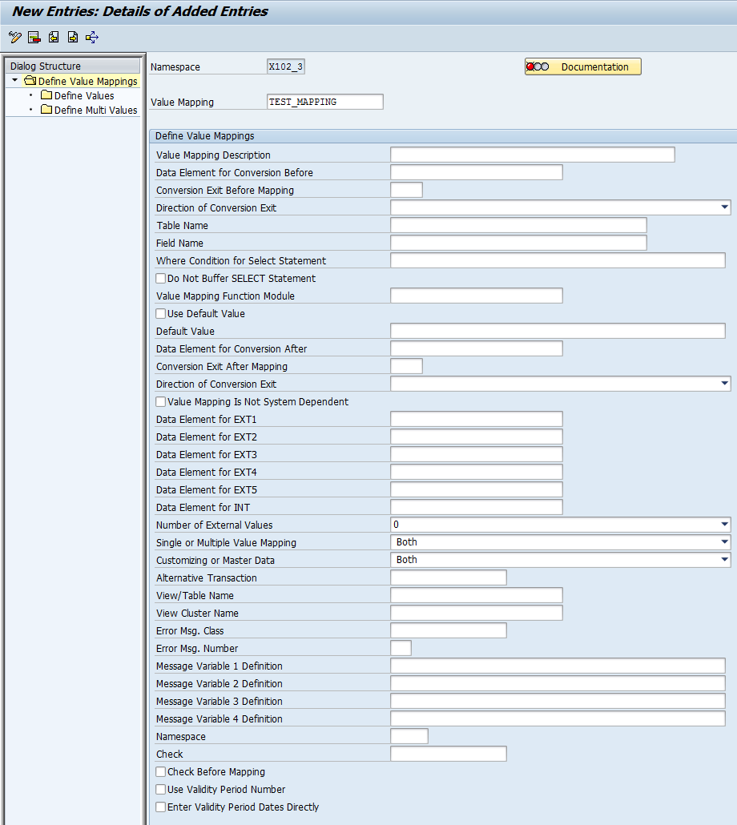
Value Mapping
Value mappings are used to derive one value in the destination structure from up to five values in the source structure and can be optionally enriched with further data from the backend system.
Value mappings can be derived from
Database table
Internal value mapping table
Value mapping function module
Default value

Slide 20
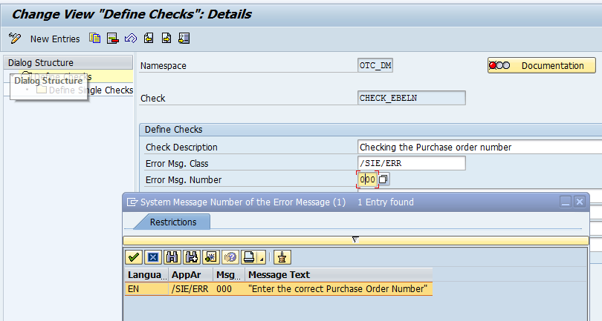
Checks
Checks can be created by choosing Define Checks and entering the namespace for which you want to create the check.
Error message, which is written to the application log if the check fails, can be defined.
Up to four variables can be defined to be used in the message. You can enter either constant values or placeholders that are replaced at runtime.
There a several ways to define a check:
Field Check: A check can be selected from the drop down box. Only if the field value fits the selected criteria, is the check successful. The following options can be selected:
Only Characters a-z
Only Characters a-z, A-Z
Alphanumeric with special characters
Not Empty
Empty
Only Characters A-Z
Numeric (Comma/Negative)
Numeric (Dot/Negative)
Numeric or Empty
Numeric (Integer)
Empty or “0”

Slide 21
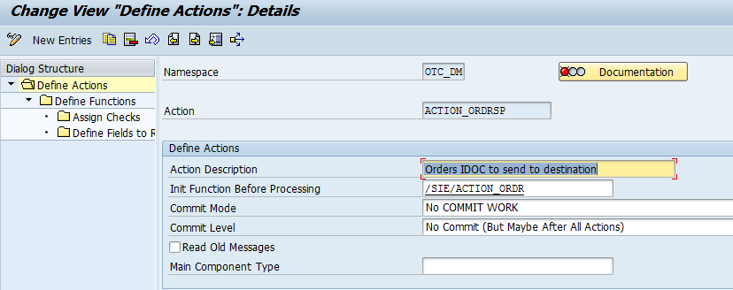
Actions
Actions define the processing steps of messages in the SAP Application Interfaces Framework. They are responsible for processing business logic at runtime.
An action consists of at least one function module call.

Slide 22
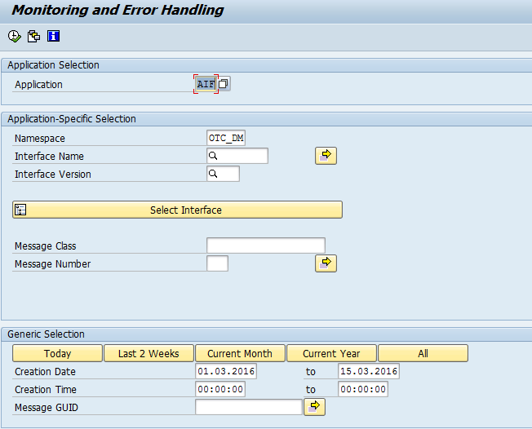
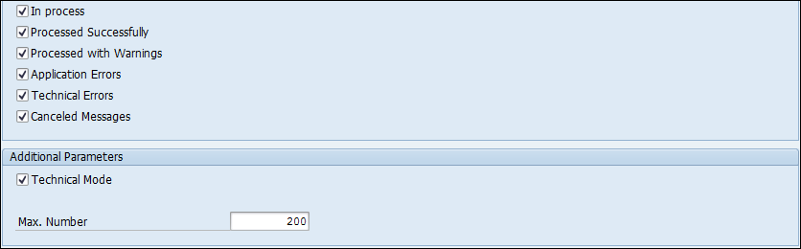
Monitoring and Error Handling
Allows us to monitor the messages based on date, namespace, interface
Allows to edit the payload
Allows to re-process or cancel the failed messages

Slide 23
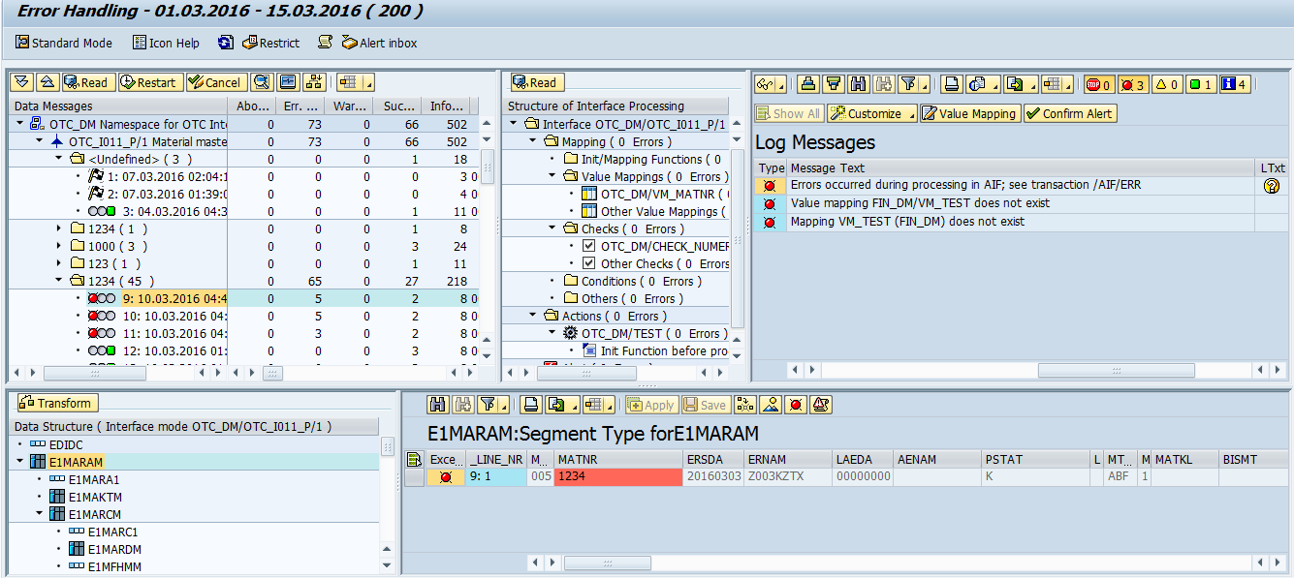
Monitoring and Error Handling

Slide 24
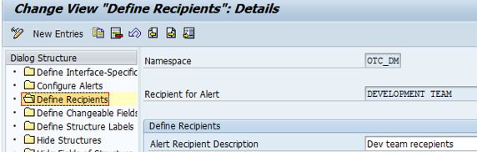
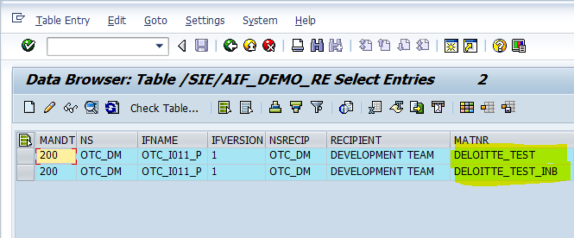
Alerts, Recipients and Key Fields
In transaction /N/AIF/ERR, we can group our interfaces based on a key field; e.g. plant, company code etc.
We can send the alerts to the assigned Recipients based on the key field. e.g. Team A should get the alert if the company code/plant is ‘XXXX’.
To use a key field-dependent recipient assignment, you have to create a recipient assignment table.
Define Recipients: The recipients defined here will be notified by alerts whenever error occurs.

Slide 25
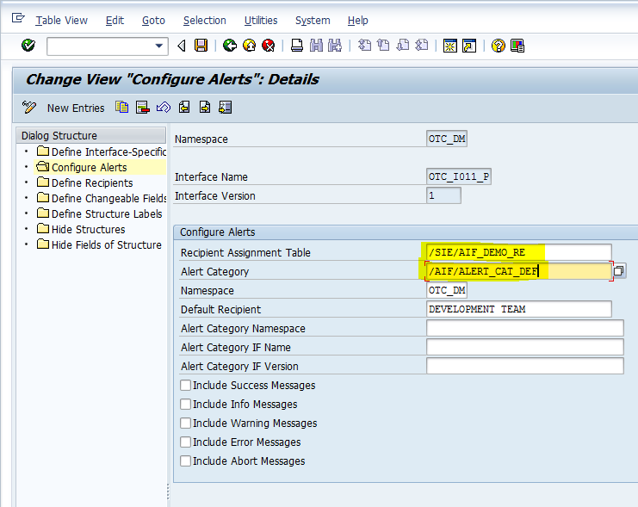
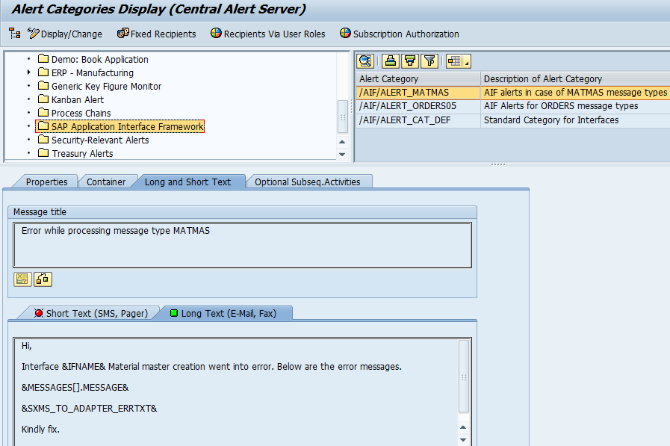
Configure Alerts
Define Namespace Specific Features Transaction - ALRTCATDEF

Slide 26
Q & A
Questions?

Slide 27
About Deloitte Deloitte refers to one or more of Deloitte Touche Tohmatsu Limited, a UK private company limited by guarantee, and its network of member firms, each of which is a legally separate and independent entity. Please see www.deloitte.com/about for a detailed description of the legal structure of Deloitte Touche Tohmatsu Limited and its member firms. Please see www.deloitte.com/us/about for a detailed description of the legal structure of Deloitte LLP and its subsidiaries. Certain services may not be available to attest clients under the rules and regulations of public accounting. Copyright © 2012 Deloitte Development LLC. All rights reserved. Member of Deloitte Touche Tohmatsu Limited
Notes:
26

